Slide 1
Internet of things
(IoT)

Slide 2
01
02
03
04
HOW IT WORKS
WHAT’S INTERNET OF THINGS
HOW DOES THIS IMPACT YOU?
IoT ADVANTAGES
05
IoT DISAVANTAGES

Slide 3
WHAT’S INTERNET OF THINGS ?
01

Slide 4
HOW IT WORKS
02

Slide 5
SENSORS AND CONNECTED DEVICES
CONNECTIVITY
01
02
DATA ANALYSIS
04
03
&
SENSORS AND CONNECTED DEVICES
ACTION AND FEEDBACK

Slide 6
AREAS OF USE
03

Slide 7
SOMETIMES, REVIEWING CONCEPTS IS A GOOD IDEA
01
MARS
Despite being red, Mars is actually very a cold
02
NEPTUNE
Neptune is the farthest planet from the Sun
03
THE SUN
The Sun is the star at the center of the Solar System

Slide 8
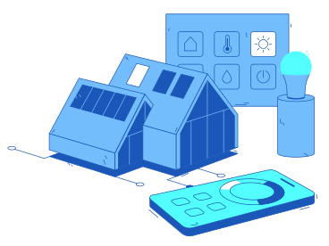


INTELLIGENT HOMES

Slide 9

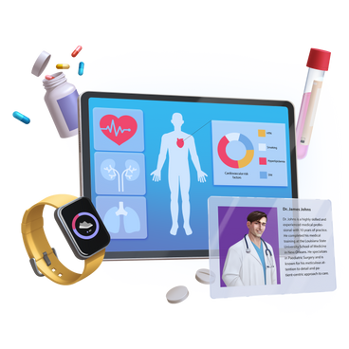

HEALTHCARE

Slide 10
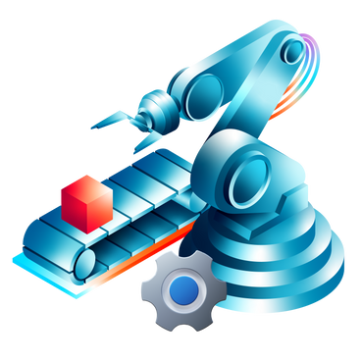
INDUSTRY

Slide 11
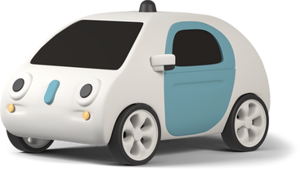
INTELLIGENT TRANSPORT

Slide 12


SMART CITY

Slide 13
02
IoT ADVANTAGES

Slide 14
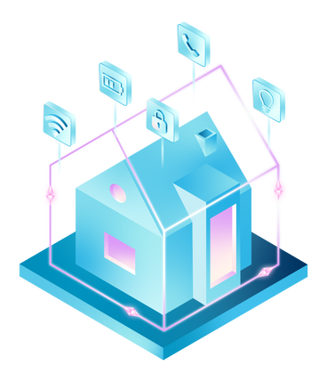
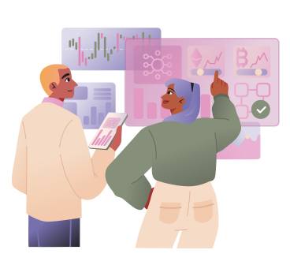

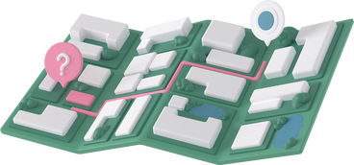

AUTOMATISATION ET EFFICACITÉ
MONITORING AND TRACKING
DATA-DRIVEN DECISION-MAKING
IMPROVING QUALITY OF LIFE

Slide 15
02
IoT DISADVANTAGES

Slide 16
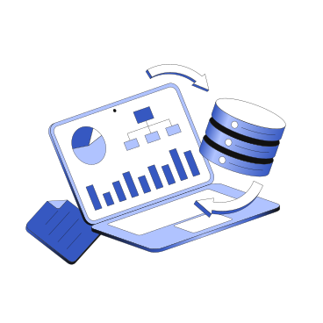


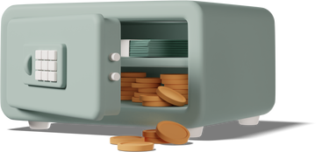
SECURITY AND PRIVACY
COST
ENVIRONMENTAL IMPACT
DATA COMPLEXITY AND MANAGEMENT

Slide 17
THANKS

